Slide 1

DIGITAL DESIGN AND COMPUTER ORGANIZATION
Basic Structure of computers T2: Chapter 1: 1.1-1.4
Department of Computer Science and Engineering

Slide 2
DIGITAL DESIGN AND COMPUTER ORGANIZATION
Computer Types T2:Ch1 1.1
Department of Computer Science and Engineering

Slide 3
Basic Structure of computers Outline
Computer Types
Functional Units:
Input Unit,
Memory Unit,
ALU,
Output Unit,
Control Unit,
Basic operational concepts

Slide 4
Basic Structure of computers Introduction T2- section 1.1
What is Computer Organization ?
Computer Organization: This field focuses on the functional units of a computer system and how they work together to execute instructions. It deals with the internal structure and operation of a computer, including its components like the CPU, memory, I/O devices, and control unit.
How is Computer Organization Different from Digital Design ?
While computer organization deals with the high-level structure and function of a computer, digital design focuses on the low-level implementation of its components.

Slide 5
Basic Structure of computers What is a computer ?
Simply put, a computer is a sophisticated electronic calculating machine that:
Accepts input information,
Processes the information according to a list of internally stored instructions and
Produces the resulting output information.
Functions performed by a computer are:
Accepting information to be processed as input.
Storing a list of instructions to process the information.
Processing the information according to the list of instructions.
Providing the results of the processing as output.
What are the functional units of a computer?

Slide 6
Basic Structure of computers Types Of Computers
Classification #1:
Micro Computers
Mini Computers
Mainframes
Super Computers
Classification #2:
Analog Computers
Digital Computers
Hybrid Computers
More General Classification:
General Purpose Computers
Special Purpose Computers

Slide 7
Types Of Computers Workstations
Workstations are industry – standard desktop computers with more computational power and high-resolution graphic display with variety of graphic input/output capability.
What is the use of a workstation ?
Workstation PC’s are usually employed in the applications of Computer Aided Design and Drafting (CADD). Simulation & Modeling, Interactive Graphic design, Multimedia and other engineering applications.

Slide 8
Types Of Computers Enterprise Systems or Mainframes
Enterprise systems or mainframes are like a family of computers with tremendous computing power beyond workstations.
Their computational activities are distributed among one main system (usually a server) and number of child nodes or intelligent PC’s with or without local computing power / processor (usually client computers) called dumb terminals.
Mainframes are preferred at business data processing corporate offices. They are quite expensive with several hard disks, RAID’s and backup storage units.
Notes:
Deploying AI and generative AI on the mainframe can help drive the modernization of IT estates. In addition, a DevSecOps framework can enable organizations to integrate s
Redundant Array of Independent (originally Inexpensive) Disks.
It is a data storage virtualization technology that combines multiple physical hard drives into one logical unit. The goals are:
Fault tolerance (data remains safe even if one drive fails).
Improved performance (read/write speed can increase).
Backup/redundancy (depending on RAID level).
oftware development, security and operations across mainframe, cloud and distributed environments to accelerate modernization.

Slide 9
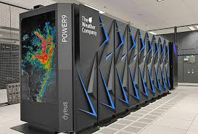
Types Of Computers Super Computers
One of the fastest computer’s type currently available, They are problem scalable.
Computational speed of a super computer is measured in terms of Floating Point Operations Per Second or FLOPS.
Examples: Cray X/MP-14 , Param – 8000, Param - Padma

Slide 10
Basic Structure of computers Functional Units T2:Ch1 1.2
A computer in its simplest form comprises five functional units:
1) Input Unit
2) Output Unit
3) Memory Unit
4) Arithmetic & Logic Unit
5) Control Unit

Slide 11
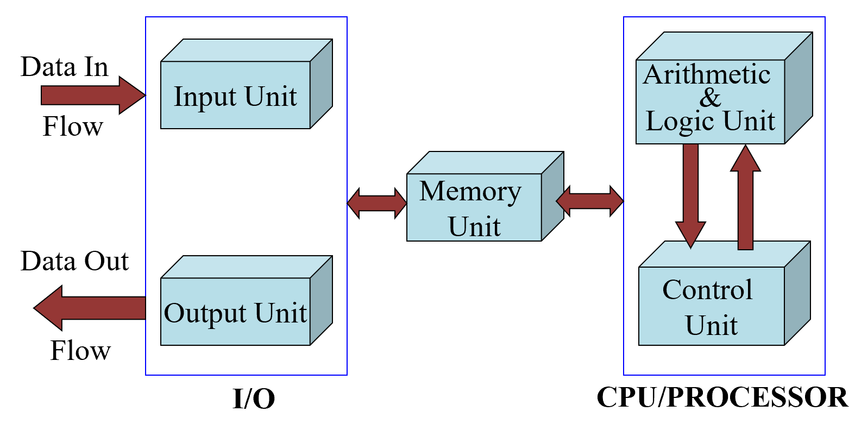
Basic Structure of computers Functional Units
The following figure depicts functional units of a computer:
Stored program concept-Serially fetching and executing ​machine code instructions​ stored in ​main memory ​by a processor that performs arithmetic and logical​ operations
Language translators- compilers
Information must be encoded -encodings- ASCII,EBCDIC

Slide 12

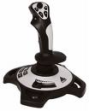
Functional Units of a Computer Input Unit
Computer accepts encoded information through input unit. The standard input device is a keyboard of a video monitor or terminal.
Whenever a key is pressed, keyboard controller sends the scanned code of that letter, digit or symbol to CPU/Memory.
Examples include Mouse, Joystick, Tablet or Digitizer, Scanner etc.

Slide 13
Functional Units of a Computer Memory Unit
Memory unit stores the program instructions, data operands on and results of computations etc.
Memory has large semi-conductor storage cells.
Words
Word length
Memory access time- time required to access one word
RAM, cache, mainmemory(slowest and largest)
Memory unit is classified as:
1. Primary /Main Memory
2. Secondary /Auxiliary Memory

Slide 14
Functional Units of a Computer Memory Unit
Primary memory is the computer memory that is directly accessible by CPU. It is comprised of DRAM and provides the actual working space to the processor. It holds the data and instructions that the processor is currently working on.
Advantages of Primary Memory
Speed: Provides fast access to data and instructions.
Direct Access: Allows the CPU to quickly read from and write to memory.
Disadvantages of Primary Memory
Limited Size: Is smaller compared to secondary memory
Notes:
Task manager
System- about
System information

Slide 15
Functional Units of a Computer Memory Unit
Secondary Memory / Mass Storage
The contents of the secondary memory first get transferred to the primary memory and then are accessed by the processor, this is because the processor does not directly interact with the secondary memory.
Advantages of Secondary Memory
Persistence: Retains data even without power.
Large Capacity: Typically offers much more storage space than primary memory.
Disadvantages of Secondary Memory
Speed: Slower access compared to primary memory.
Notes:
CD magnetic tapes

Slide 16
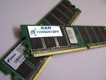
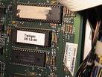
Functional Units of a Computer Memory Unit
1. Main memory is classified again as RAM and ROM.
RAM is termed as Read/Write memory or user memory that holds run time program instruction and data.
ROM holds system programs and firmware routines such as BIOS, POST, I/O Drivers that are essential to manage the hardware of a computer.
RAM
ROM
Notes:
RAM – used in cache memory-volatile
ROM- gaming applications, loading OS-Non volatile
Both random access
Cache memory is built from SRAM, while main memory is DRAM. Both are types of RAM, but serve different roles.

Slide 17
Functional Units of a Computer Memory Unit
The key difference between RAM and ROM lies in their:
Purpose:
RAM: Temporary storage for data and program instructions, lost when power is turned off.
ROM: Permanent storage for firmware or system software.
Write capability:
RAM: Read-write (data can be written, modified, and erased).
ROM: Read-only (data cannot be modified after manufacture).
Volatility:
RAM: Volatile (loses data when power is turned off).
ROM: Non-volatile (retains data even without power).

Slide 18
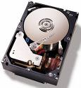
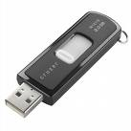
Functional Units of a Computer Memory Unit
2. Secondary /Auxiliary Memory:
While primary storage is essential, it is volatile in nature (i.e. its contents will be lost in the absence of power) and expensive too. Additional requirement of memory would be supplied as auxiliary memory at cheaper cost.
Secondary memory are magnetic memories viz Floppy disk, Hard disk, Magnetic tape, CD-ROM etc.
Secondary memories are non volatile in nature (contents will not be lost in the absence of power).

Slide 19
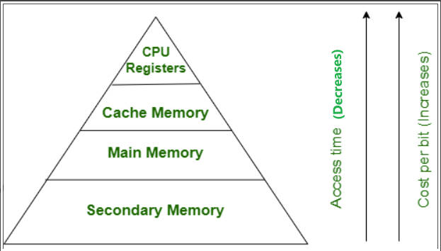
Functional Units of a Computer Memory Hierarchy

Slide 20
Functional Units of a Computer ALU
What is an ALU?
An ALU is a digital circuit that performs arithmetic and logic operations on binary numbers.
ALUs are essential components of computer systems, as they enable the execution of various computational tasks.
How does an ALU work?
ALUs process binary data using logic gates, which perform operations like AND, OR, NOT, and XOR. The combination of these gates allows ALUs to execute complex arithmetic and logic operations.

Slide 21
Functional Units of a Computer Functions of an ALU
Operations are executed in the Arithmetic and Logic Unit (ALU).
Arithmetic operations such as addition, subtraction.
Logic operations such as comparison of numbers.
In order to execute an instruction, operands need to be brought into the ALU from the memory.
Operands are stored in general purpose registers available in the ALU.
Access times of general purpose registers are faster than the cache.
Results of the operations are stored back in the memory or retained in the processor for immediate use.

Slide 22
Functional Units of a Computer Output Unit
Computer returns the computed results, error messages, etc., via output unit.
The standard output device is a video monitor, LCD/TFT monitor.
Other output devices are printers, plotters to take a paper copy of the results, programs, graphs called print out or a hardcopy
Printers types: Dot Matrix printer, Inkjet printer, Laser printer. . .

Slide 23
Functional Units of a Computer Control Unit
Coordinates activities: The control unit oversees the operations of all components within the CPU.
Issues timing signals: It sends signals like MEMR (Memory Read), MEMW (Memory Write), IOR (Input Output Read), and IOW (Input Output Write) to control data transfers.
Governs data transfers: These timing signals determine when specific operations should occur.
Interprets instructions: The control unit decodes instructions to determine the required actions.

Slide 24
Functional Units of a Computer Control Unit
Operation of a computer can be summarized as:
Accepts information from the input units (Input unit).
Stores the information (Memory).
Processes the information (ALU).
Provides processed results through the output units (Output unit).
Operations of Input unit, Memory, ALU and Output unit are coordinated by Control unit.
Instructions control “what” operations take place (e.g. data transfer, processing).
Control unit generates timing signals which determines “when” a particular operation takes place.

Slide 25
Functional Units of a Computer
Main conceptual events/operations of a computer
A set of instructions which perform a given task, called a program must reside in the main memory of computer during its execution.
The CPU fetches those instructions sequentially one-by-one from the main memory, decodes them and perform the specified operation on associated data operands in ALU.
Processed data i.e. useful information will be displayed on an output unit.
All activities pertaining to processing and data movement inside the computer machine are governed by control unit.

Slide 26
Functional Units of a Computer
Information Handled by a Computer:
Instructions/machine instructions
Govern the transfer of information within a computer as well as between the computer and its I/O devices
Specify the arithmetic and logic operations to be performed
List of instructions is called a Program(in memory)
Data (numbers or encoded chars)
Used as operands by the instructions. Eg(Binary, BCD, ASCII,EBCDIC)

Slide 27
Functional Units of a Computer
Information in a computer -- Instructions
Instructions specify commands to:
Transfer information within a computer (e.g., from memory to ALU)
Transfer of information between the computer and I/O devices (e.g., from keyboard to computer, or computer to printer)
Perform arithmetic and logic operations (e.g., Add two numbers, Perform a logical AND).
A sequence of instructions to perform a task is called a program, which is stored in the memory.
Processor fetches instructions that make up a program from the memory and performs the operations stated in those instructions.
What do the instructions operate upon?

Slide 28
Functional Units of a Computer MCQ
Which is NOT a characteristic of secondary memory? a) Non-volatile storage b) Cheaper per bit than primary memory c) Directly accessible by the CPU d) Provides large storage capacity
Which of the following best describes the function of the Control Unit (CU)? a) Performs logical comparisons of data. b) Generates timing and control signals to coordinate computer operations. c) Stores frequently accessed data and instructions. d) Acts as a permanent repository for system programs.

Slide 29
Functional Units of a Computer MCQ
Which is NOT a characteristic of secondary memory? a) Non-volatile storage b) Cheaper per bit than primary memory c) Directly accessible by the CPU d) Provides large storage capacity
Ans: c) Directly accessible by the CPU
Which of the following best describes the function of the Control Unit (CU)? a) Performs logical comparisons of data. b) Generates timing and control signals to coordinate computer operations. c) Stores frequently accessed data and instructions. d) Acts as a permanent repository for system programs.
Answer: b) Generates timing and control signals to coordinate computer operations

Slide 30
Functional Units of a Computer MCQ
Which of the following statements is correct regarding primary vs secondary memory? a) Primary memory is slower but larger than secondary memory. b) Secondary memory is volatile, whereas primary memory is non-volatile. c) Primary memory is directly accessible by the CPU, while secondary memory is not. d) Both memories are equally fast but differ in size.

Slide 31
Functional Units of a Computer MCQ
Which of the following statements is correct regarding primary vs secondary memory? a) Primary memory is slower but larger than secondary memory. b) Secondary memory is volatile, whereas primary memory is non-volatile. c) Primary memory is directly accessible by the CPU, while secondary memory is not. d) Both memories are equally fast but differ in size.
Answer: c) Primary memory is directly accessible by the CPU, while secondary memory is not

Slide 32
THANK YOU
Team DDCO
Department of Computer Science

